Slide 2
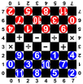
1.3 Damath - Math Checkers (Board Game)
Requirements
Participants already can count and calculate with whole numbers between 0 and 11. Participants know, that multiplication by 0 is always 0 and divided by 0 is not possible, so this move is not allowed.
Students already know the rules of the game Checkers (Dame)
Objectives
The game DAMATH is a game to exercise calculating with numbers between 0 and 11.
Students practice playing the reckoning. You have fun.

Slide 3
1.3 Damath - Math Checkers (Board Game)
Tools, Materials and Organisation
Take a checkers-board (8 by 8 fields) for each 3 players.
The white fields of the board are marked with arithmetic symbols. You can mix different symbols or, much easier, you start first just with addition and so on.
Each group needs 12 white and 12 black men. These men are marked with whole numbers from 0 to 11.
Use the copy template from 1.2 Checkers!
The lesson takes 45 minutes. If the participants don’t know the rules of the game Checkers, you have to play Checkers first for another 45 minutes.

Slide 4
1.3 Damath - Math Checkers (Board Game)
Description of the Lesson
First part of the lesson (40 minutes)
Explain the game “Damath” (the participants already know the game Checkers).
Arrange groups with 2 persons.
Each group is sitting on an extra table.
The role of the persons in the group: two are playing against each other.
When capturing the opponent's piece. The score is obtained by calculating the number value of player's piece which captures the opponent's piece and the captured piece. The mathematical operation used depends where the player's piece lands after the capture.
The participants play a certain number of times the game "Damath". They always have to begin with 12 men in the starting position (see picture). The Players get only points, if they calculate in the right way when jumping over an opponent. The result of this calculation is to be noted.
Second part of the lesson (5 minutes)
Each participant is presenting his score.
The winner of the group has the most scores, but everybody has learned a lot by exercising the caculations.

Slide 5
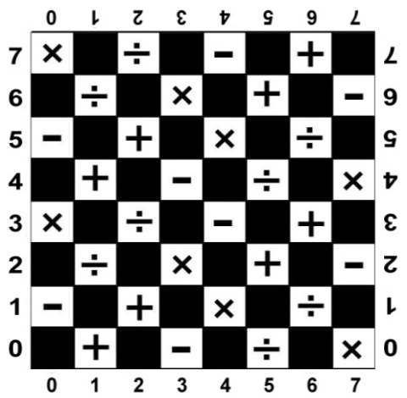
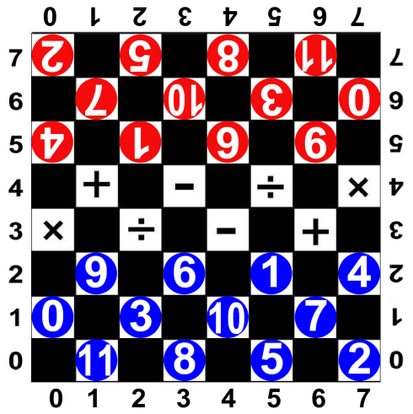
1.3 Damath - Math Checkers (Board Game)
Useful Hints
You can construct Damath by your own.
It is very important, that the teacher knows the abilities of the participants.
Start, if necessary, with easier calculations, e.g. you can mark the white fields just with + and the men with numbers between 0 and 5 – so your participants calculate e.g. just 2+3=5 or 0+5=5 or 1+2=3.

Slide 6
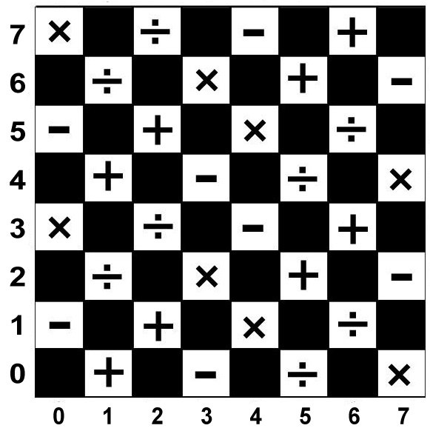
0
6.
1
7
2
8
3
9.
4
10
0
6.
5
11
1
7
2
8
3
9.
4
10
5
11

Slide 7
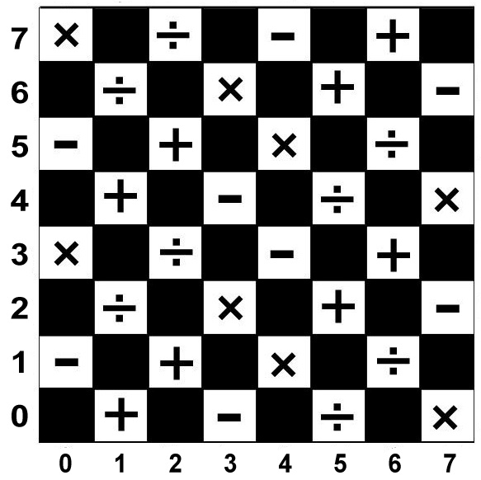
0
6.
1
7
2
8
3
9.
4
10
5
11
9.
6.
1
4
0
3
10
7
11
8
5
2

Slide 8
than black moves (0|5) to (1|4)
Start the game example:
white moves first (3|2) to (2|3)
2
5
8
11
7
10
3
0
4
1
6.
9.
9.
6.
1
4
0
3
10
7
11
8
5
2

Slide 9
Now white 6 can jump over black 4 and remove it to the side
At the same time white gets 2 points, because: 6-4=2
2
5
8
11
7
10
3
0
1
6.
9.
4
Calculation white:
6-4=2
6.
9.
1
4
0
3
10
7
11
8
5
2

Slide 10
the next move could be black 6 from (4|5) to (3|4)
Now white 1 from (5|2) to (4|3)
4
2
5
8
11
7
10
3
0
6.
1
6.
9.
Calculation white:
6-4=2
9.
1
4
0
3
10
7
11
8
5
2

Slide 11
black 6 must now jump over white 1 from (3|4) to (5|2) and remove white 1
Black has to culculate: 6+1=7
4
2
5
8
11
7
10
3
0
6.
1
9.
6.
Calculation black:
6+1=7
Calculation white:
6-4=2
1
9.
4
0
3
10
7
11
8
5
2

Slide 12
Now white has to decide to jump over black 6 with white 7 or white 10 – points?
White 10 jumps over black 6 and removes it - new calculation for white?
5
1
4
2
8
11
7
10
3
0
6.
1
9.
Calculation black:
6+1=7
Calculation white:
6-4=2
10+6=16
The sum is now 18 points.
9.
6.
4
0
3
10
7
11
8
5
2

Slide 13
Now we play all together – tell me your next move!
(press Esc to do the moves by hand!)
5
1
4
2
8
11
6.
7
10
3
0
6.
1
9.
Calculation black:
6+1=7
Calculation white:
6-4=2
10+6=16
The sum is now 18 points.
10
9.
4
0
3
7
11
8
5
2

Slide 14
Basic forms of calculation:
Addition, Subtraction, Multiplication and Division
2
5
8
11
7
10
3
0
4
1
6.
9.
9.
6.
1
4
0
3
10
7
11
8
5
2

Slide 15
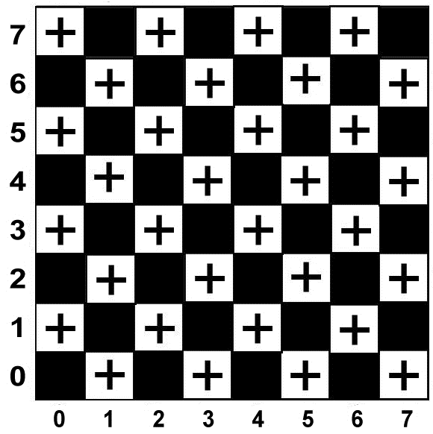
Basic form of calculation: Addition
2
5
8
11
7
10
3
0
4
1
6.
9.
9.
6.
1
4
0
3
10
7
11
8
5
2

Slide 16
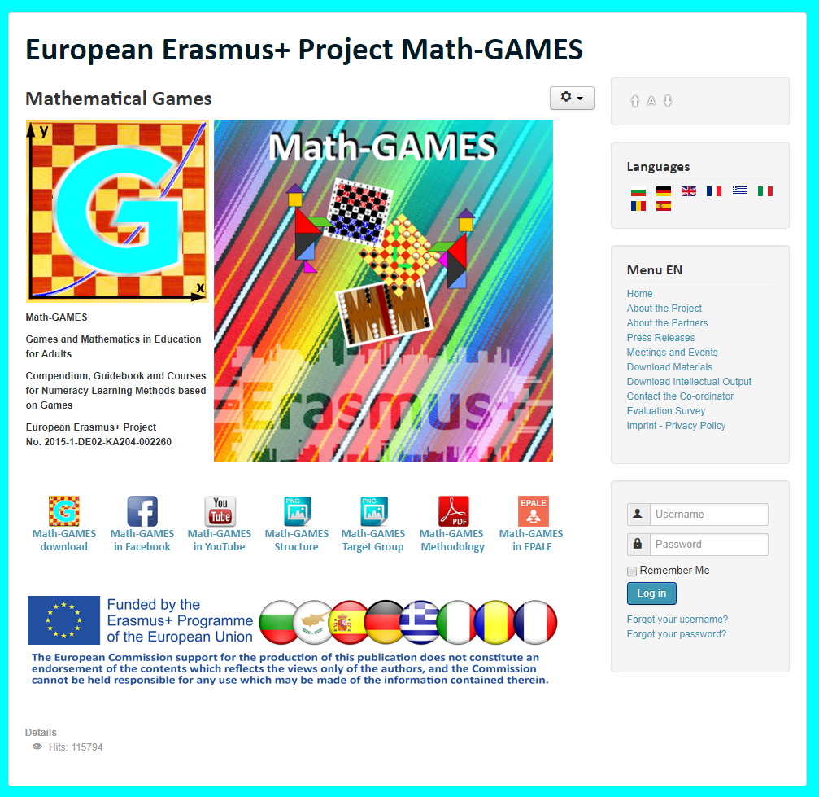
The result is: Play Games and and learn Mathematics more easily.
Our Project-Website will help you: www.math-games.eu

